Slide 1
NodeJs Session
Sashidharan Kanagaraj

Slide 2
Global Objects
Global objects are global in nature and they are available in all modules.
These objects are modules, functions, strings and object as follow
__filename & __dirname, etc
setTimeout, clearTimeout & setInterval, etc
Console & Process, etc
Read Eval Print Loop(REPL) represents a computer environment like window console or unix commands is entered.

Slide 3
Function Expression
First-Class Function
Everything you can do with other type you can do with functions.
You can use the function like strings, numbers, etc. (i.e. pass around them around, set variables equal to them, put them in array, and more)
Expression
A block of code that results in a value
Function expression are possible in JavaScript because function are first-class.

Slide 4
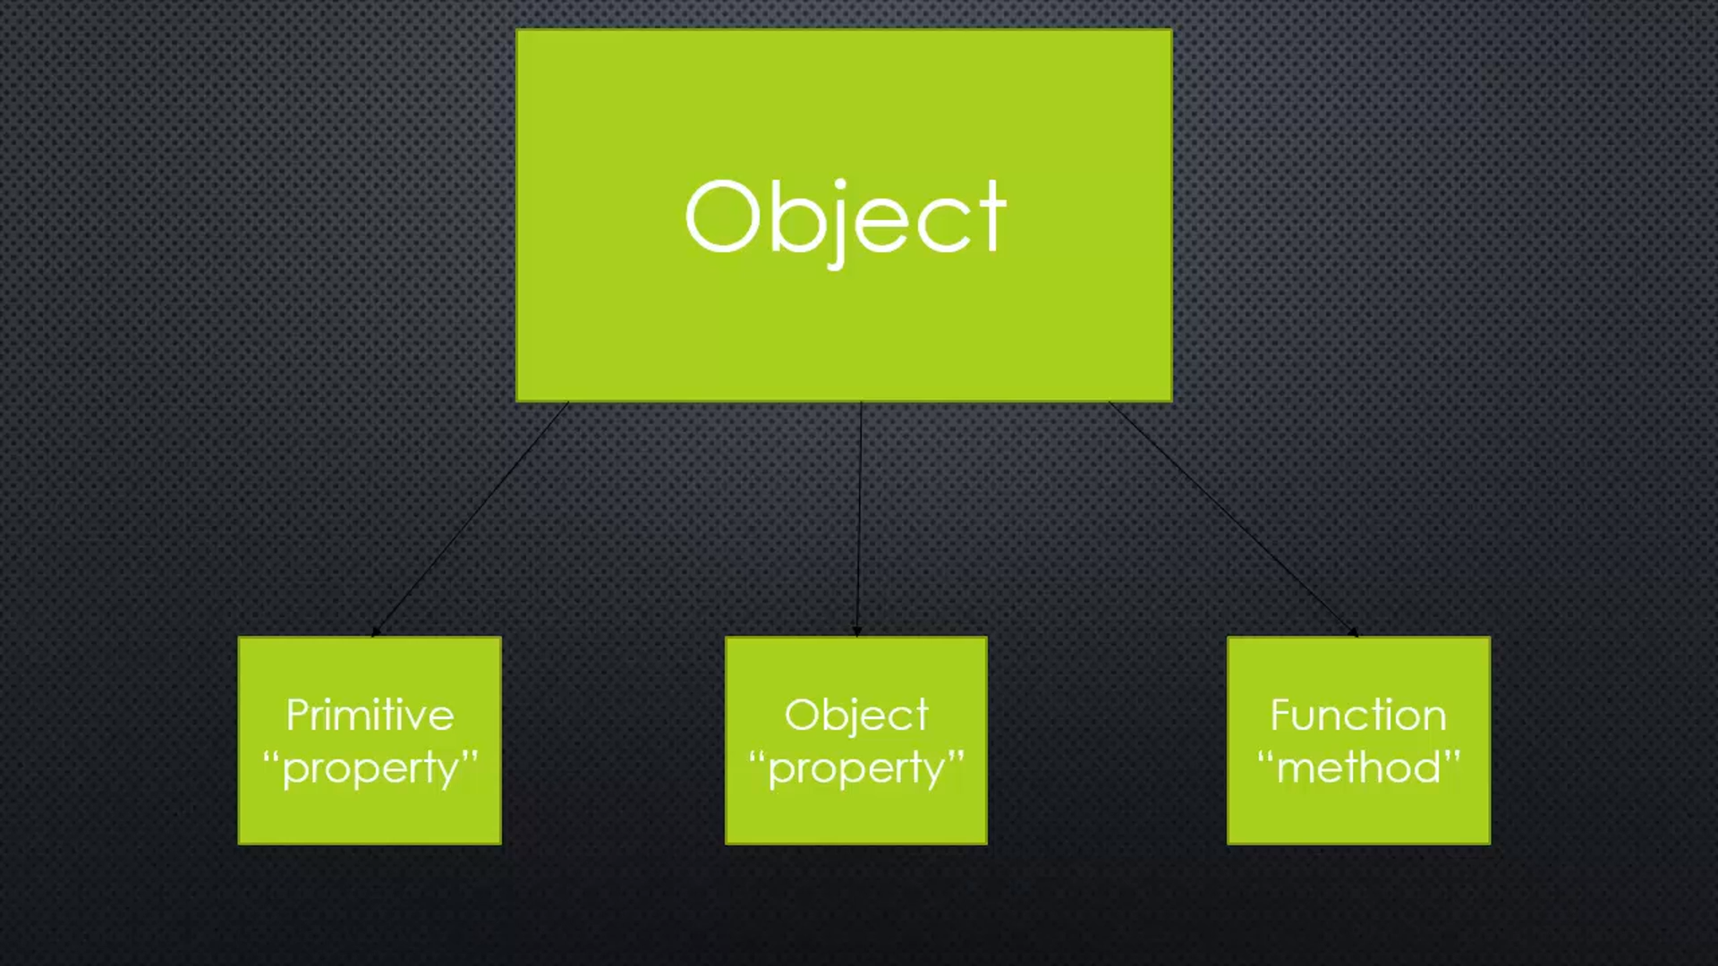
Objects & Object Literals
Name which maps to the value is objects or collection of name/value pairs.
Name may be defined more than once, but only can have one value for the context.
Eg: “name: value” => firstname: “Nodejs”
Object Literals separated by commas and surrounded by curly braces

Slide 5
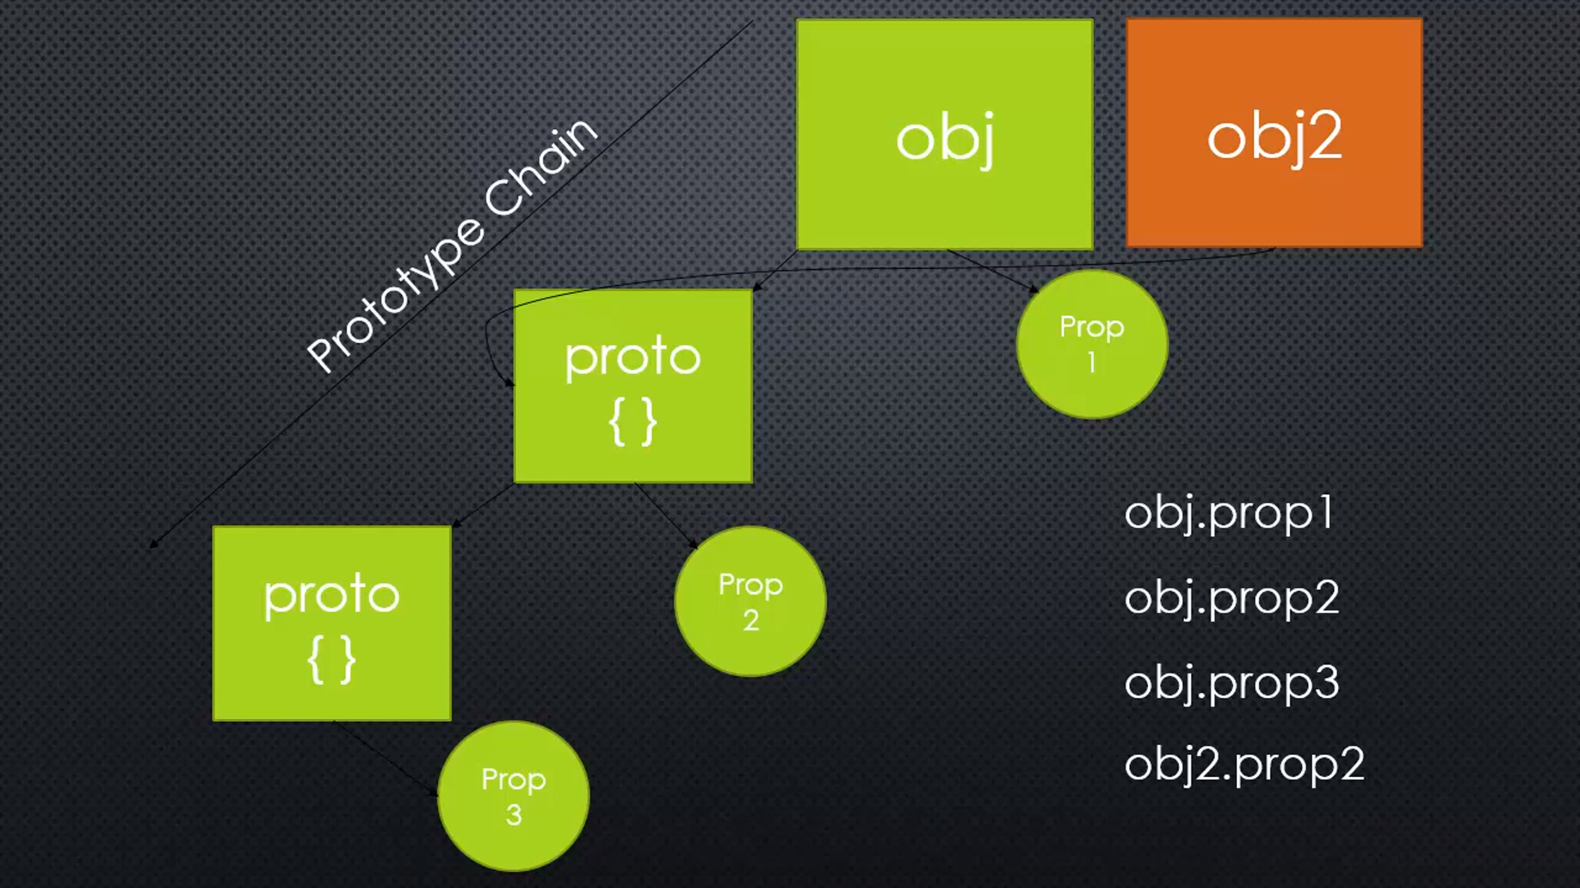
Prototype Inheritance& Constructors
Prototype Inheritance
One object get access to the properties and methods of another object
Prototype
Prototype is another object, but it can attach the properties and method
Function Constructors
A normal function that is used to construct objects

Slide 6
Require Function
Resolving: To find the absolute path of the file.
Loading: To determine the type of the file content.
Bundling: All exports from the module into one object. Which makes both the require and module objects local to every file we require.
Evaluating: This is what the VM eventually does with the loaded code.
Caching: Entire code has been cached so that, we don’t go over all the steps another time. Just read once and pulled from cache

Slide 7
Module
Fundamental features of node is the module system this allows us to load functionality into our app
Reusable block of codes whose existence does not accidentally impact other code
Example:
Read/Write from the file system,
Connect a Database
Startup a webserver

Slide 8
Type of Modules
Core Modules
Modules that come shipped with Node.js, e.g. https, os, fs, net, etc
Third Party Modules
Modules that you install from any package manager. For example, to simplify our web API development we use express, or to deal with date and time we use moment
Local Modules
These are the modules that we create for our own use. These modules basically consist of core business logic of our code

Slide 9
Core Modules
The core modules include bare minimum functionalities of Node.js.
These core modules are compiled into its binary distribution and load automatically when Node.js process starts.
However, you need to import the core module first in order to use it in your application.
They get preference in loading even if a third-party module exists with the same name.

Slide 10
Third Party Modules
Third party Node.js module can be downloaded using NPM (node package manager)
NPM is a command line tool that installs, updates or uninstalls Node.js packages in your application.
It is also an online repository for open-source Node.js packages.
The node community around the world creates useful modules and publishes them as packages in this repository.
It is responsible for managing all the Nodejs packages and modules present in an application.

Slide 11
NPM
NPM performs the operation in two modes:
Global - In the global mode, NPM performs operations which affect all the Node.js applications on the computer.
Local - In the local mode, NPM performs operations for the particular local directory which affects an application in that directory only

Slide 12
Local Modules
Local modules are modules created locally in your Node.js application.
These modules include different functionalities of your application in separate files and folders.
You can also package it and distribute it via NPM, so that Node.js community can use it.
For example, if you need to do logging you can create a module for it, which can be reused in your application

Slide 13
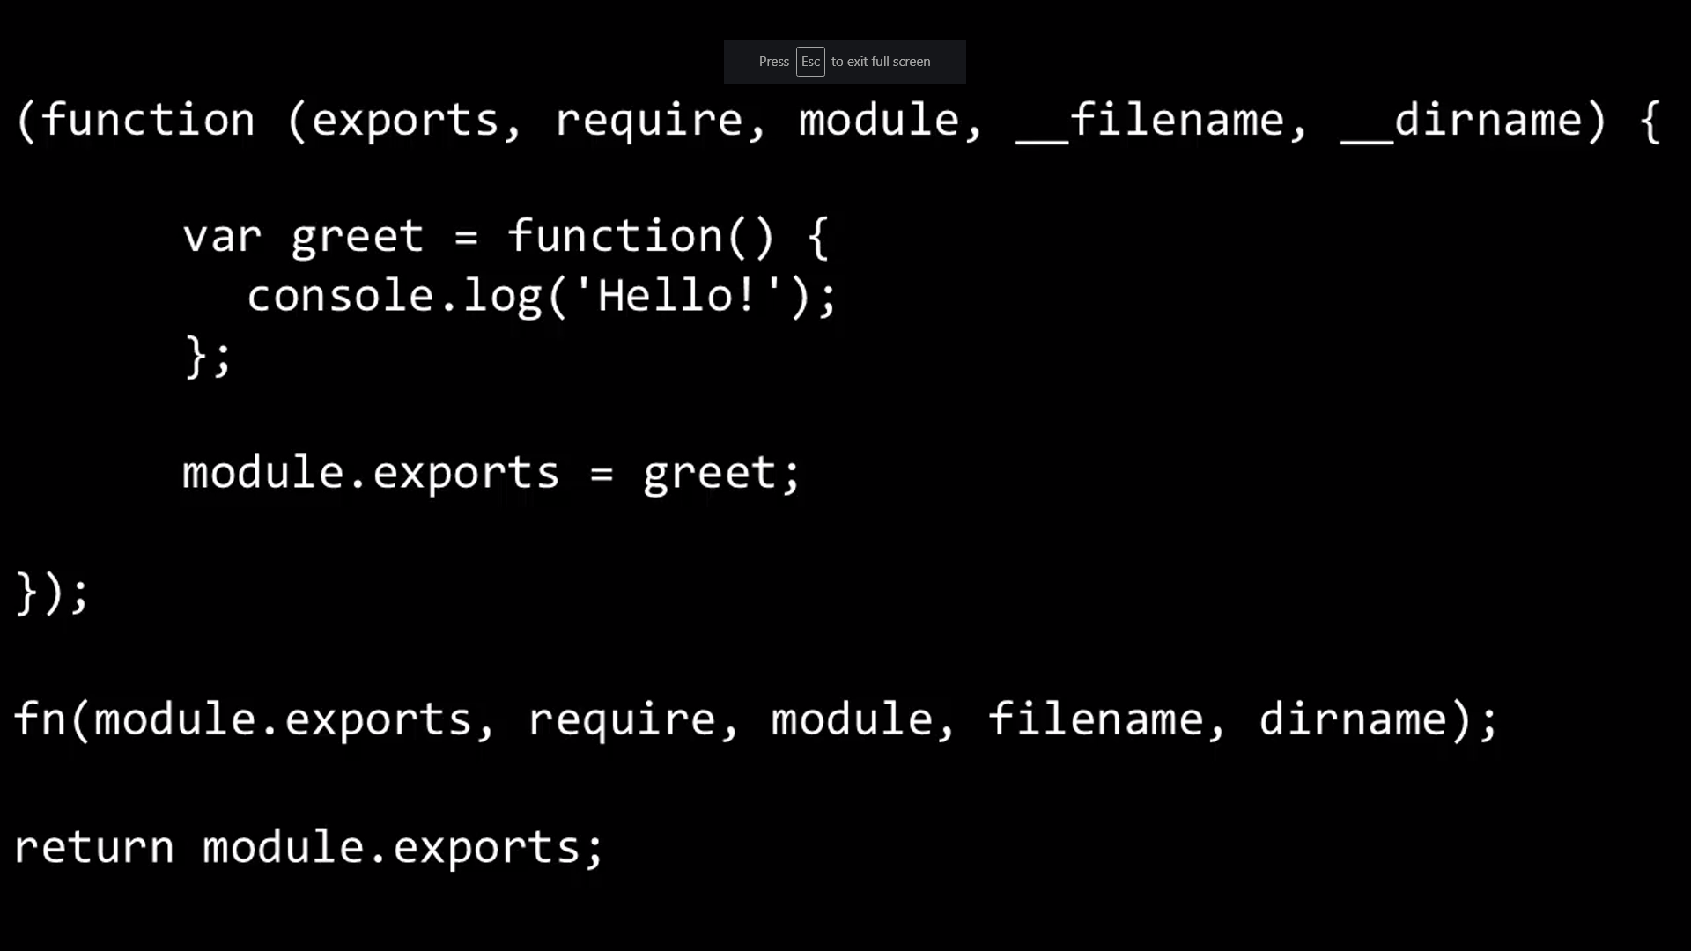
Module.exports & Require
Require is a function, that you pass a path location
Module.exports is what the require function returns
This both works because the your code has been wrapped in function that is given these things as function parameters

Slide 14
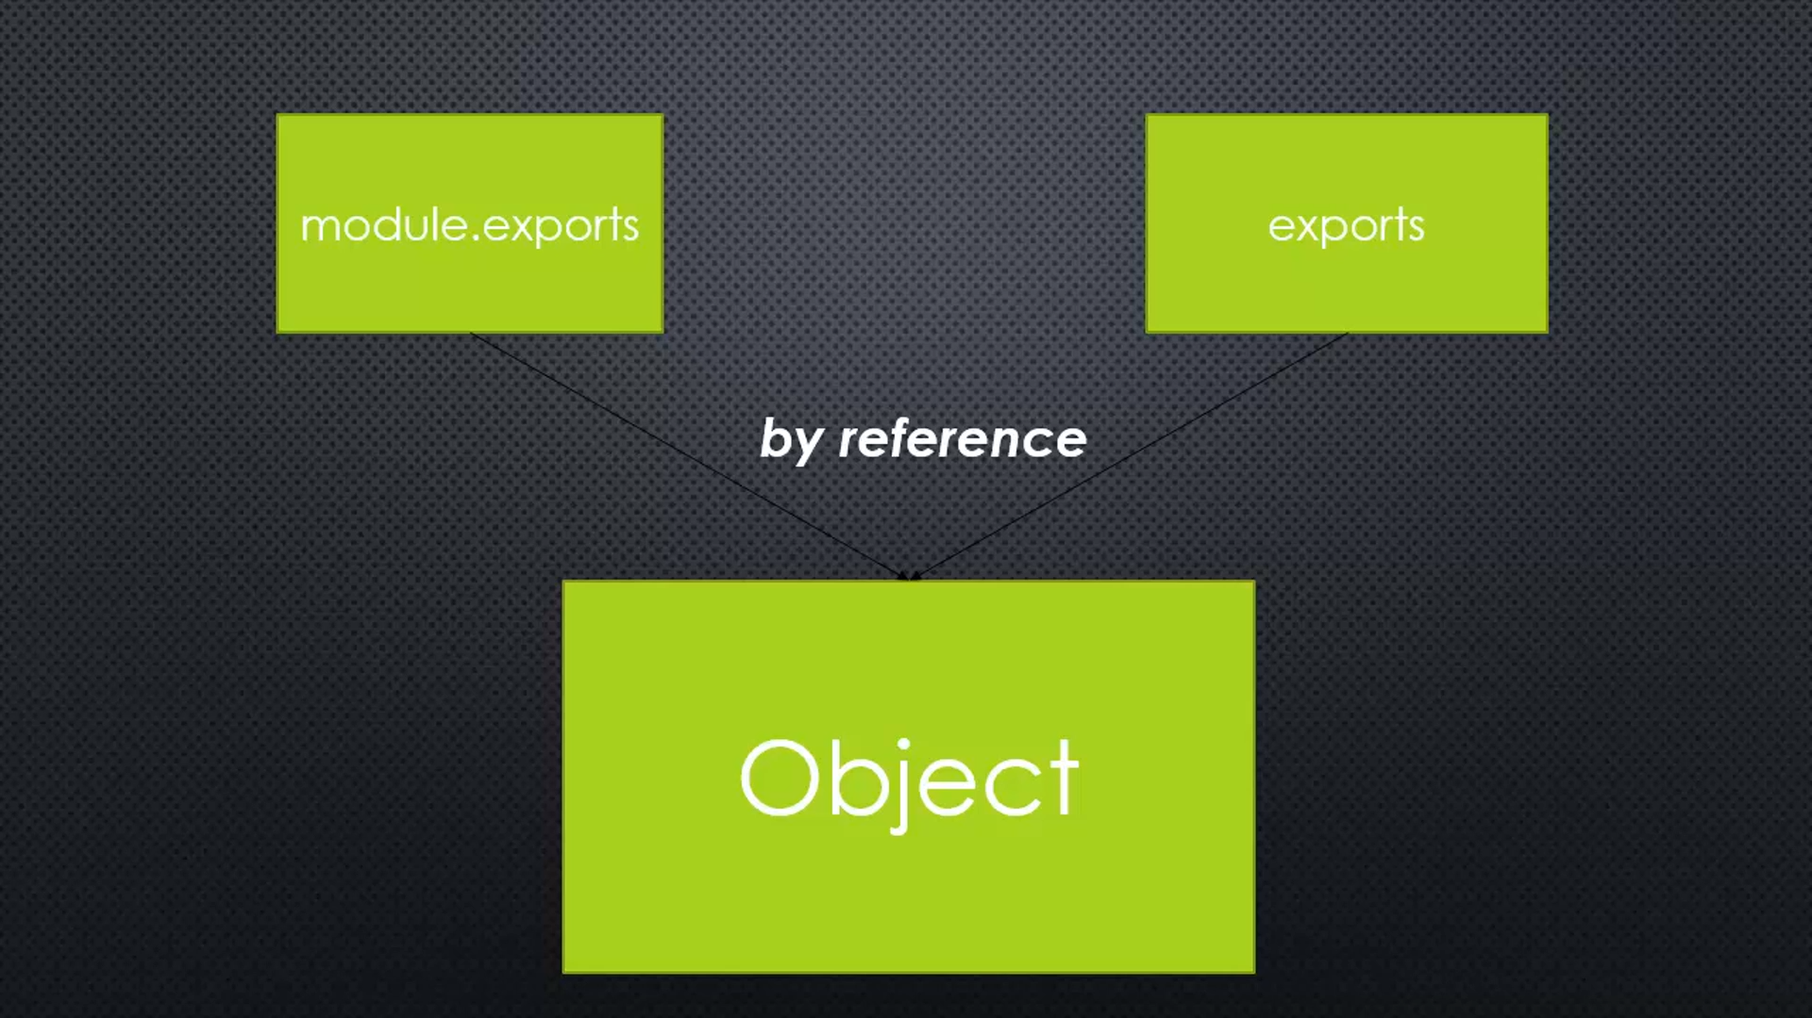
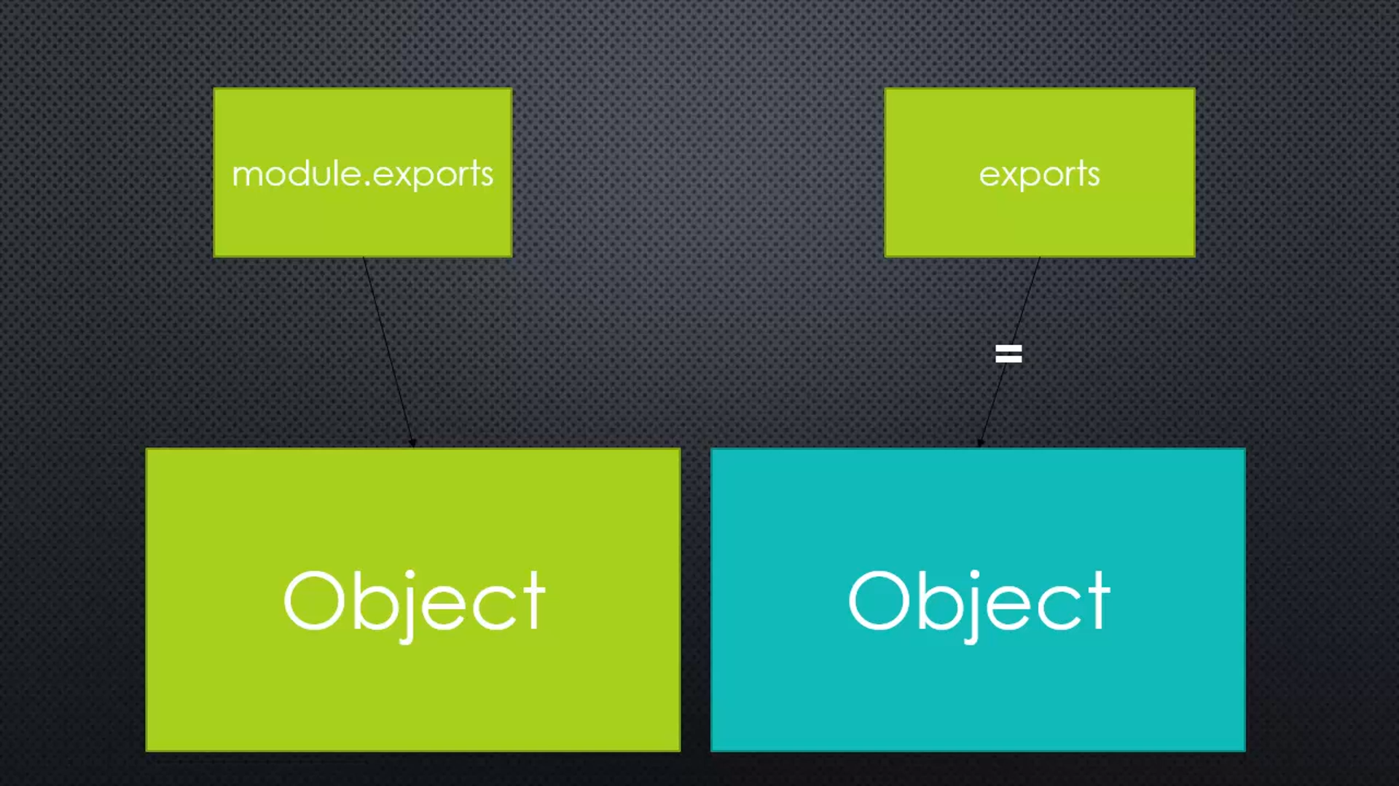
Exports vs Module.exports
Exports is a reference of module.exports. So, assigning the value to the exports is a neat shortcut
But, exports is not a reference to module.exports for all the time!.
If you assign anything to the module.exports, then exports is no longer reference to it, and loss it all power.

Slide 15
Queries

Slide 16
Assignment
Assignment1:
Third Party Modules: (https://underscorejs.org/)
Step 1. Require underscore core module
Step 2. Using underscore module to do any 2 function of arrays & object
Assignment 2:
Local Modules:
Step1: Create a local module to add two numbers
Step2: Create a config file and make a default value..
Step3: Require the created local module and config
Step4: Execute the local module using the configured

